Slide 1
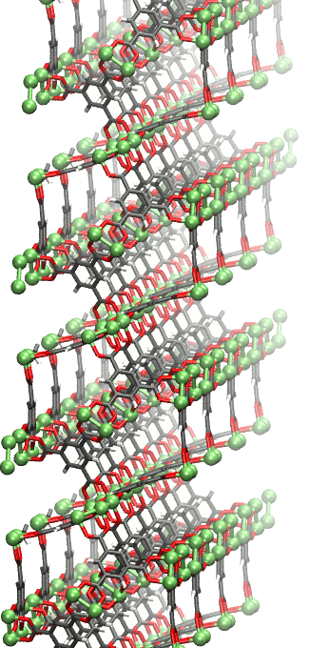
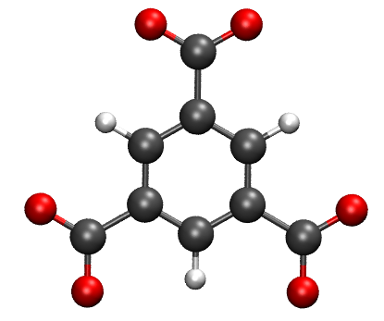
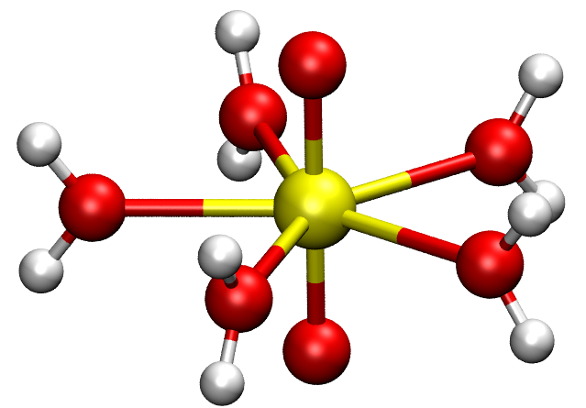
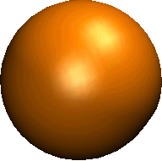
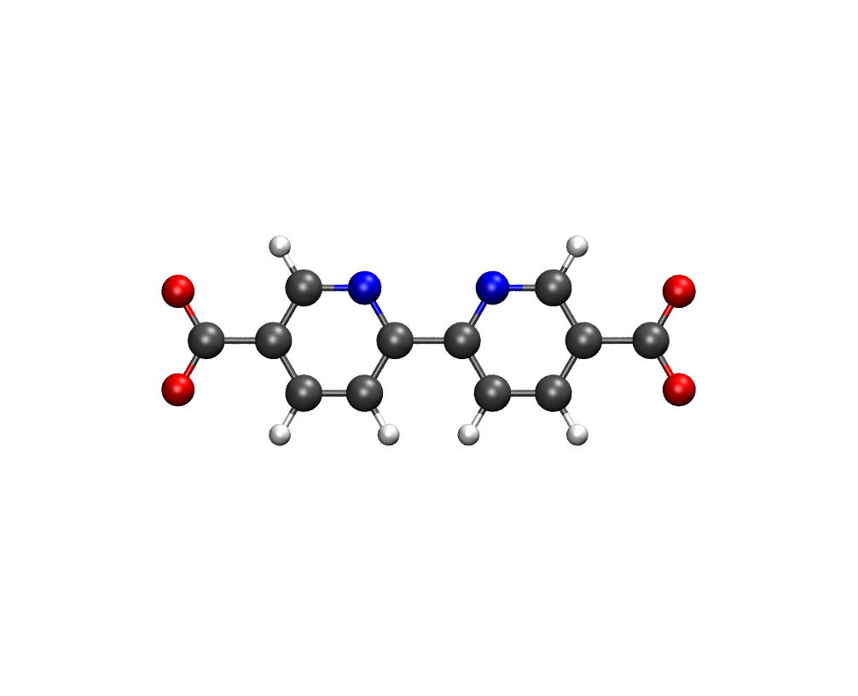
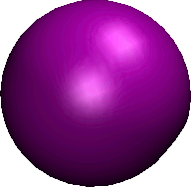
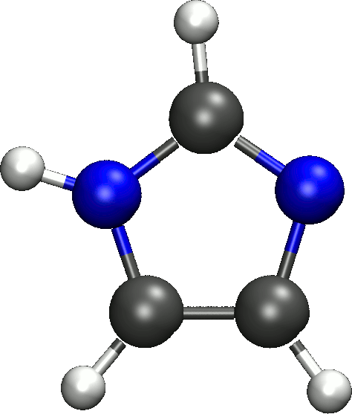
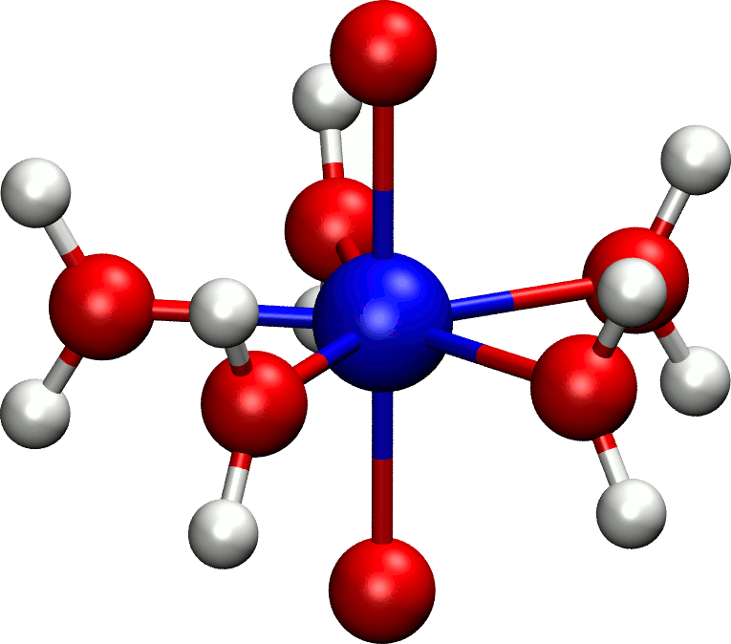
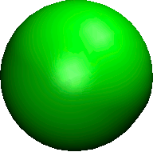
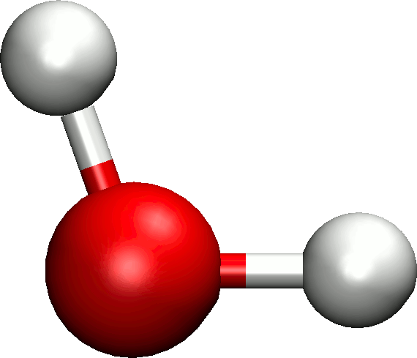
Proposal 1
Figure 1
Competition between linkers and solvent
Selective binding of one heavy element
Actinyl and An³⁺/Ln³⁺ ions

Slide 2
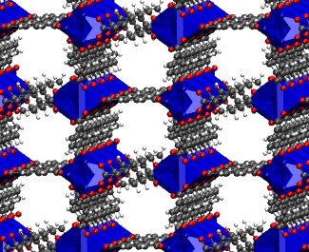
Proposal 1
Figure 1
Competition between linkers and solvent
Selective binding of one heavy element
Actinyl and An³⁺/Ln³⁺ ions

Slide 3
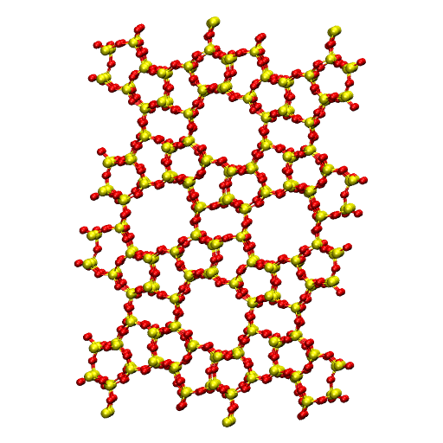
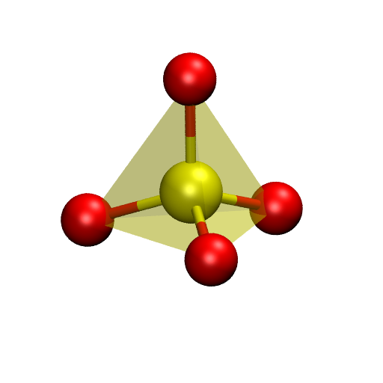
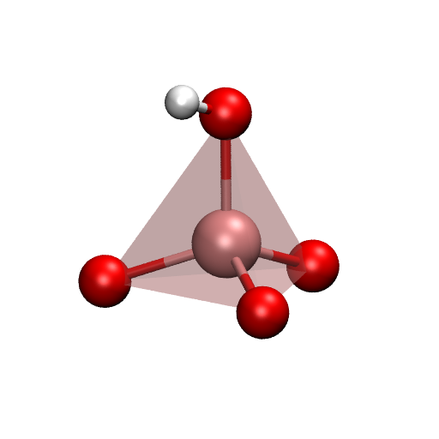
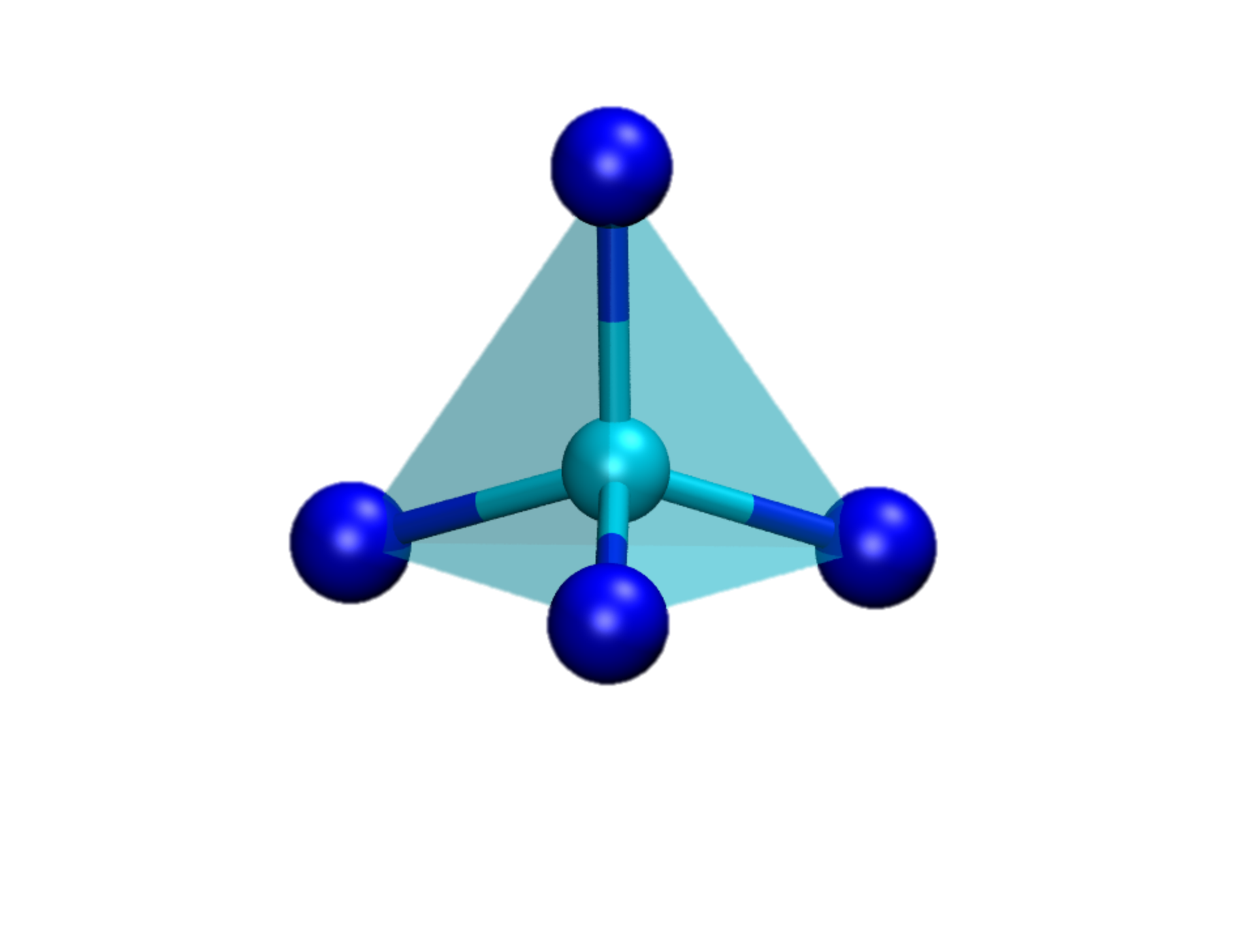
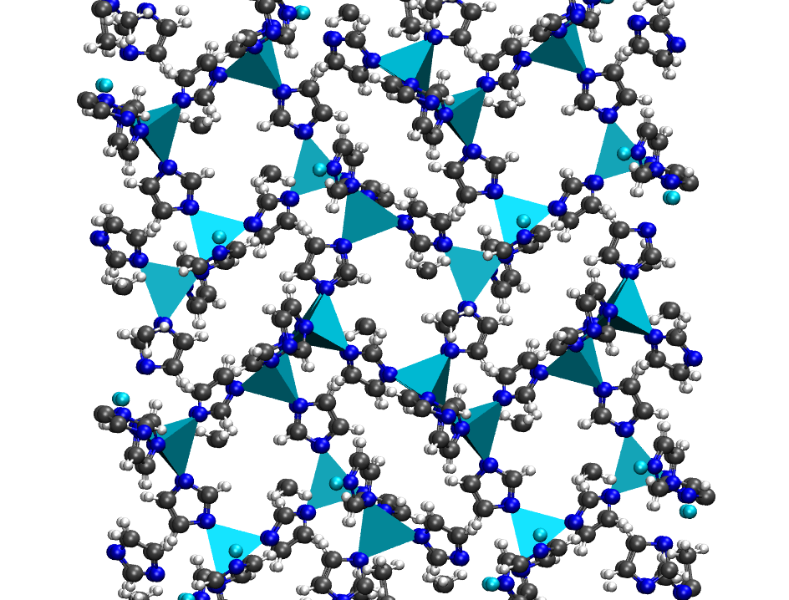
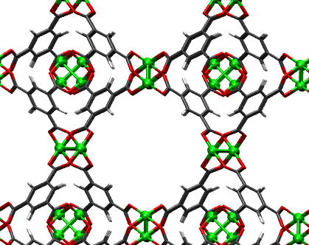
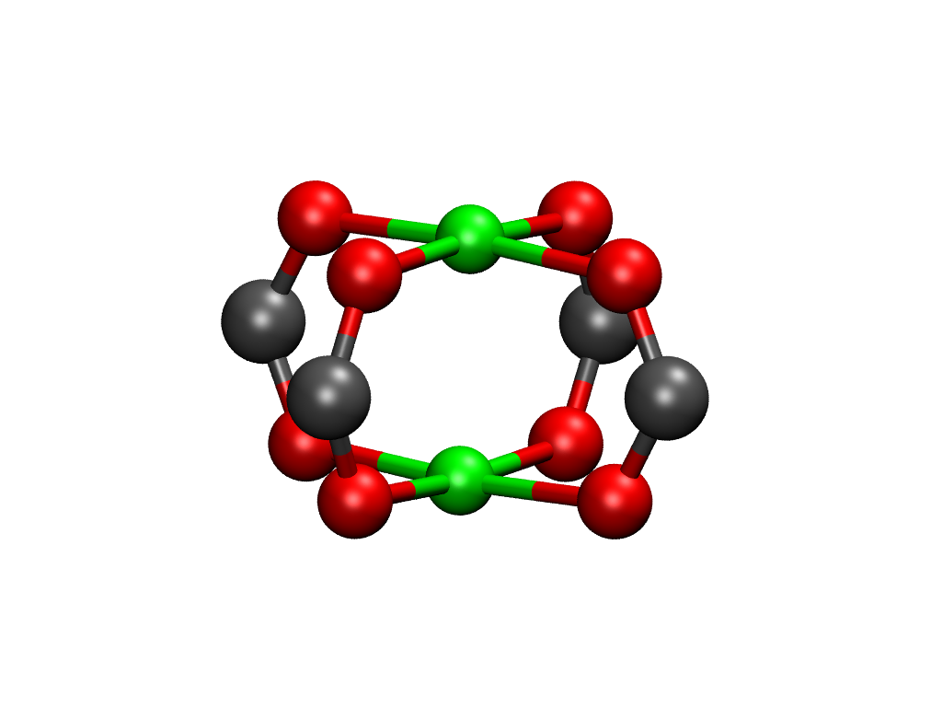
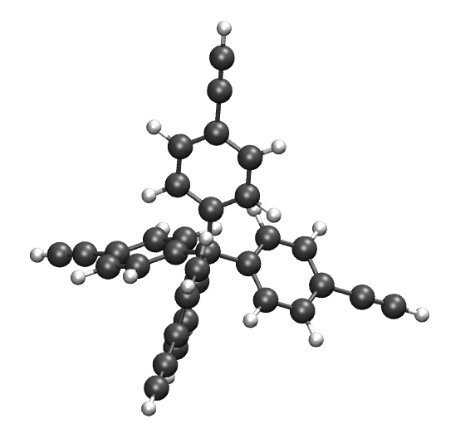
Proposal 1
Figure 2
Building Units
3D Network
MFI
SiO₄⁻
AlO₄X⁻
(X=H or other cation)
Zeolite
Zeolitic imidazolate framework (ZIF)
ZIF-1
Tetrahedrally
Coordinated
Metal
Imidazole
linker
Zn²⁺
imidazole
Cu₂(btc)₃
Metal Connector
Organic Linker
Metal organic framework (MOF)
Cu²⁺
btc
Monomers
Porous polymer network (PPN)
TEPM
Notes:
TEPM (Tetrakis(4-ethynylphenyl)methane )

Slide 4
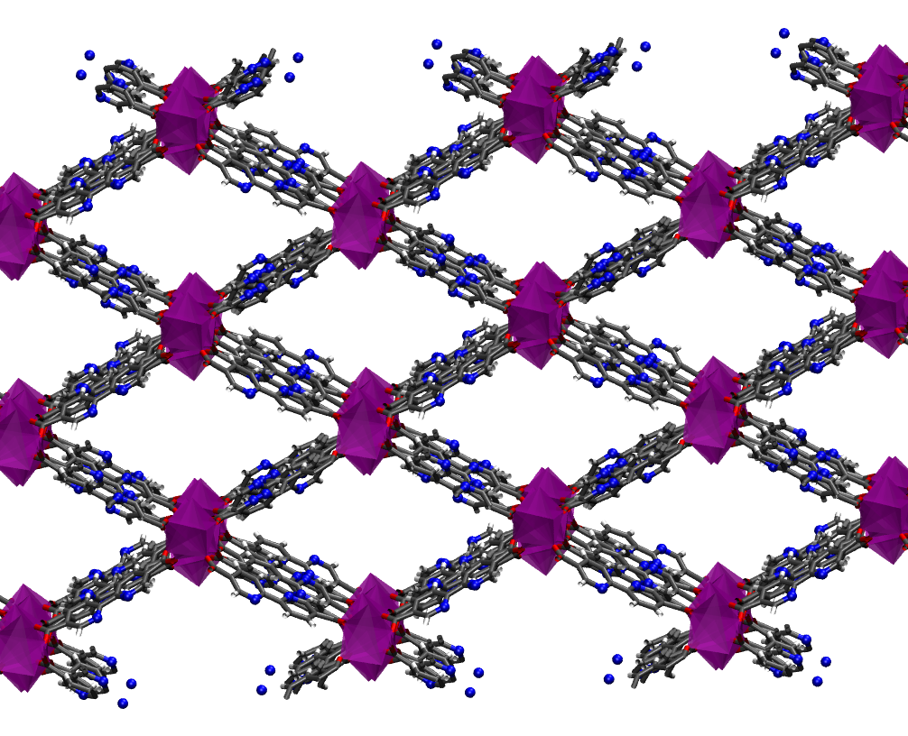

Proposal 1
Figure 3
3D Network
Connector
Linker
+
Ln³⁺
bypdc
Ln₂(bypdc) ₃(H2O)₃

Slide 5
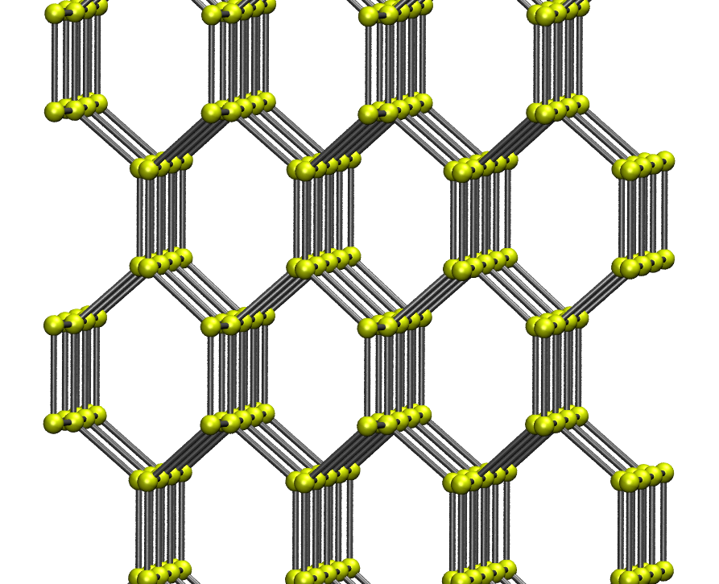
Proposal 2
Figure 1
Guest Induced
Luminescence
Antenna
Effect
Dope Metal:
Tune Emission

Slide 6
Proposal 2
Figure 1
Guest Induced
Luminescence
Antenna
Effect
Dope Metal:
Tune Emission

Slide 7
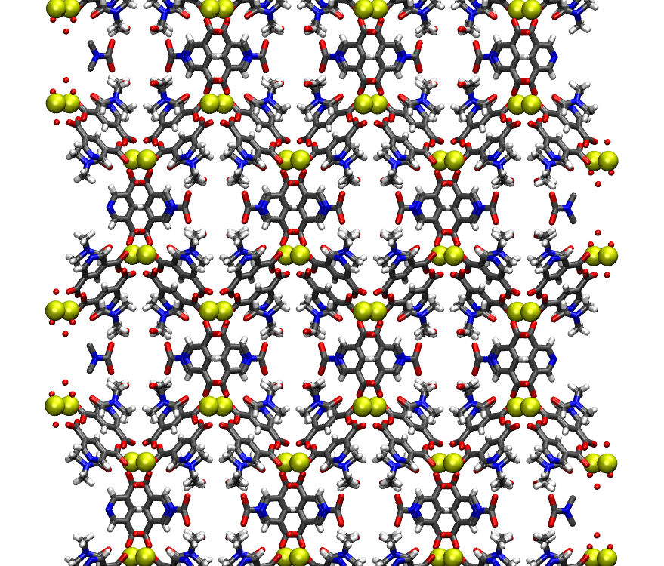
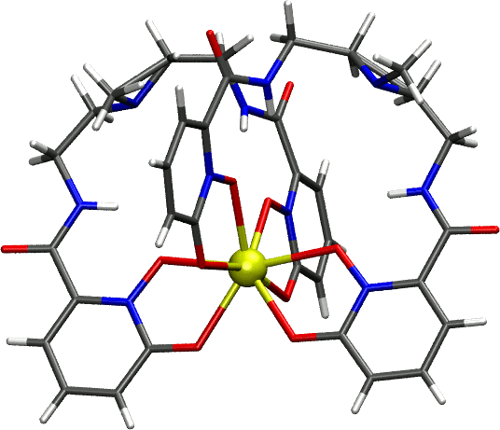
Proposal 2
Figure 1

Slide 8
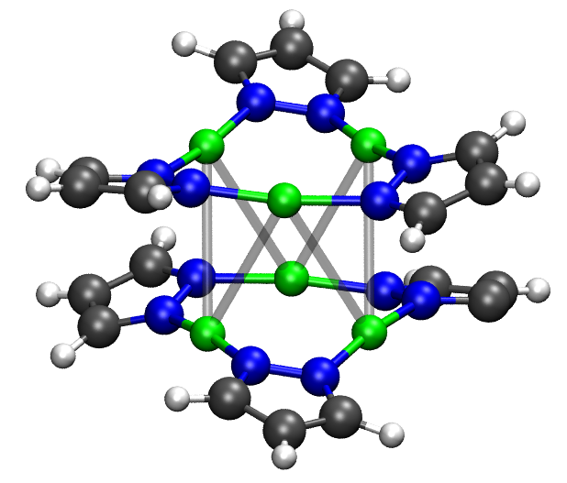
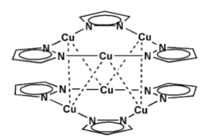

Slide 9
Proposal 2
Figure 1
Sarin (GB)
Soman (GD)
VX
Sulfur mustard (HD)
Lewisite (L)
PMPA? (check Ref 51)
CEES
CEPS
DES
DEClP
DECNP
DIFP
MPA (poor reactivity sim)
DMMP (ads sim for G-agents and VX)
HKUST1:
HD and CEES (Ref 45)
CEPS
CEClP and DECNP (Ref 48)
Zn-DMCP
DIFP and DES
Mil-101 an Mil53 modified Fws
For DIFP
DMMP For HKUST1 MOF5 and NENU-11
Alpha-PbO2: MPA

Slide 11
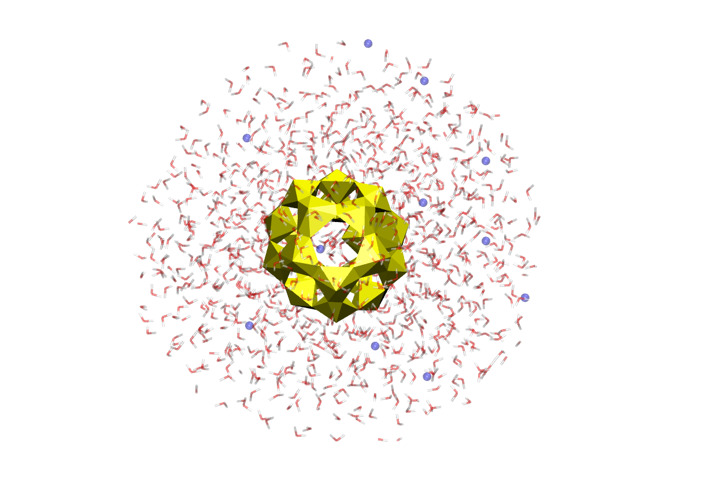
Proposal 3
Figure 2

Slide 12
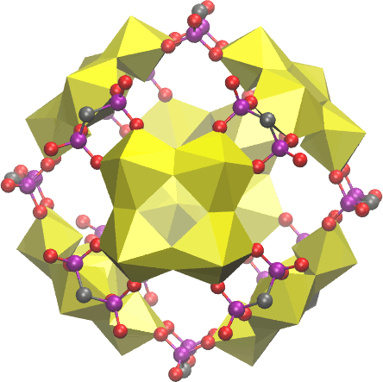
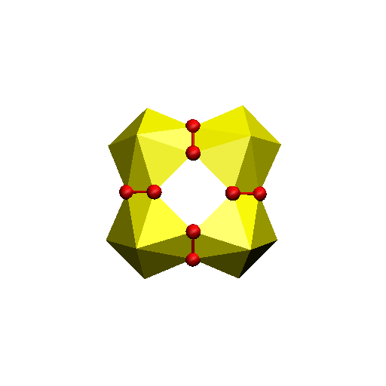
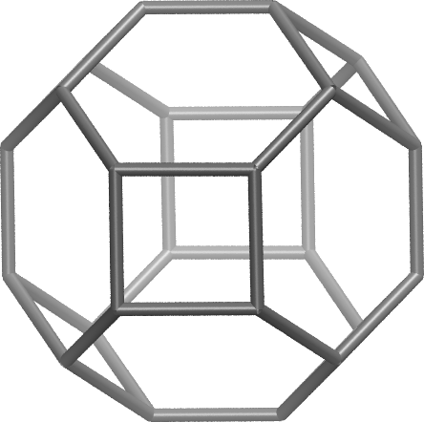

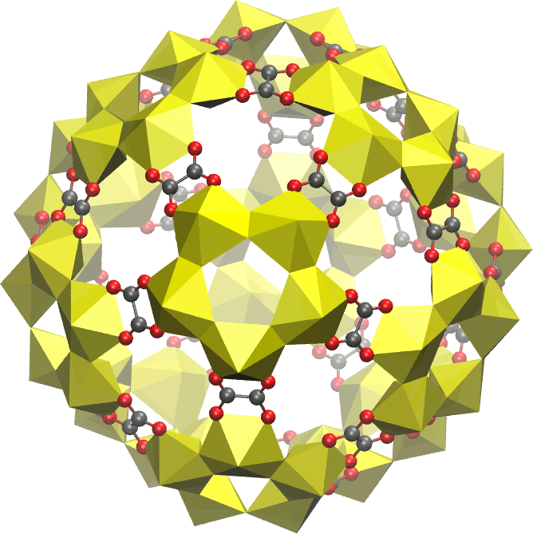
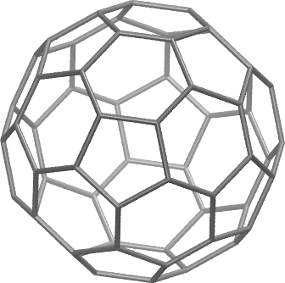

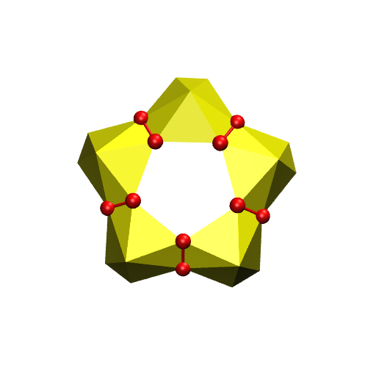
Proposal 3
Figure 3
Notes:
Figure on yls in MOFs

Slide 14
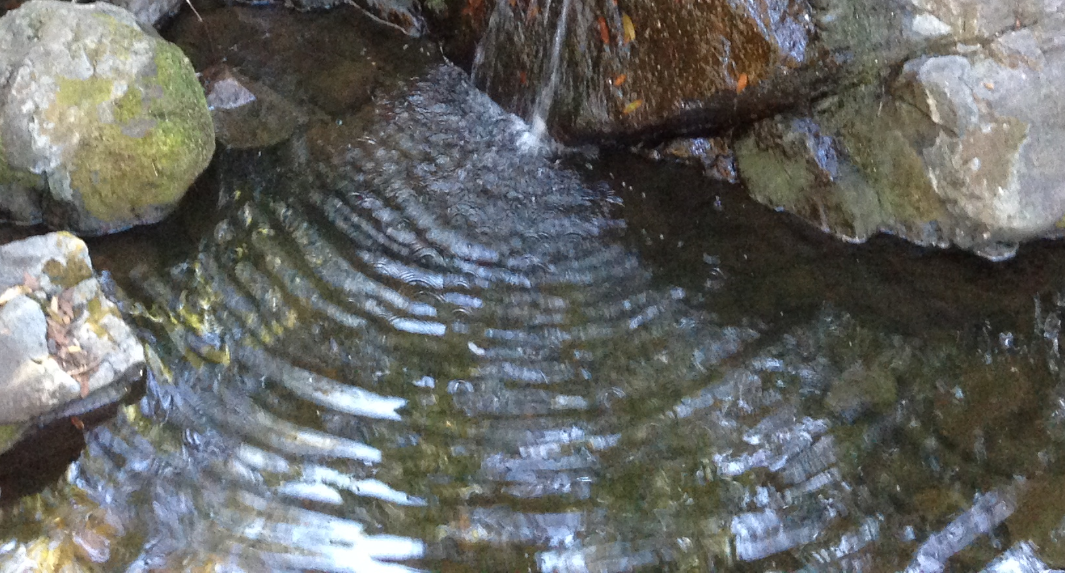
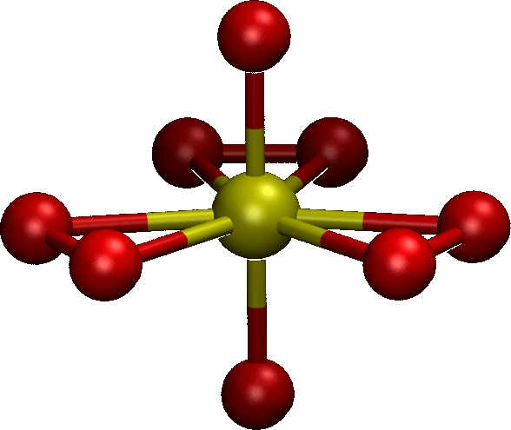
Proposal 3
Figure 1

Slide 15
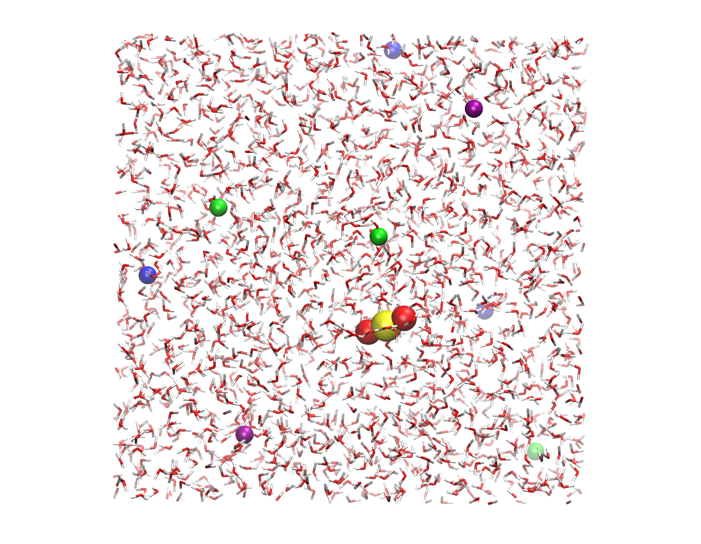
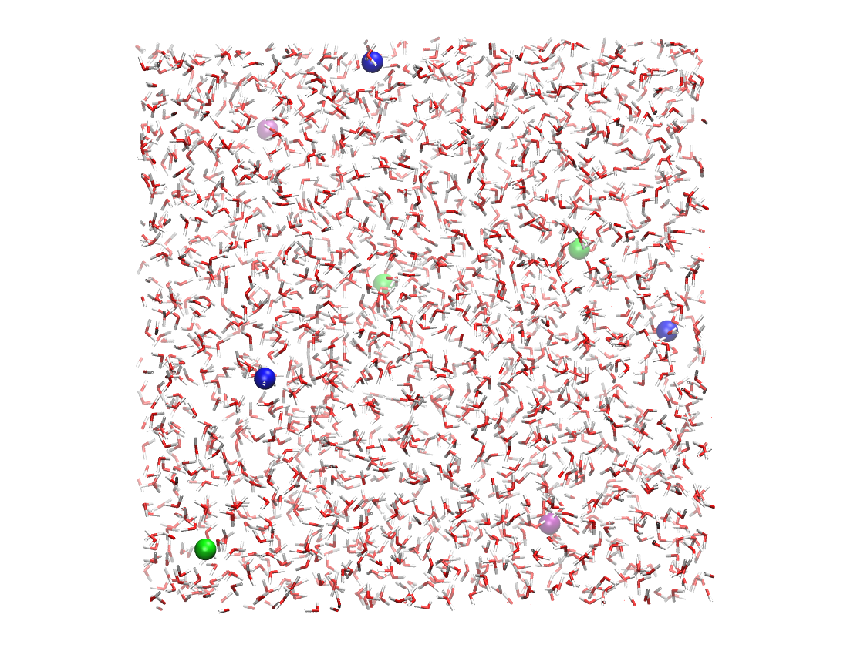
Proposal 1
Figure 1

